Slide 1
Shell Bootcamp 2024 3 Reflections for Week #4
Achal Shankar Gupta
Date : 19-Sep-2024

Slide 2

About Me
“I am not afraid of storms for I am learning how to sail my ship.”

Slide 3

My learnings from this week!

Slide 4
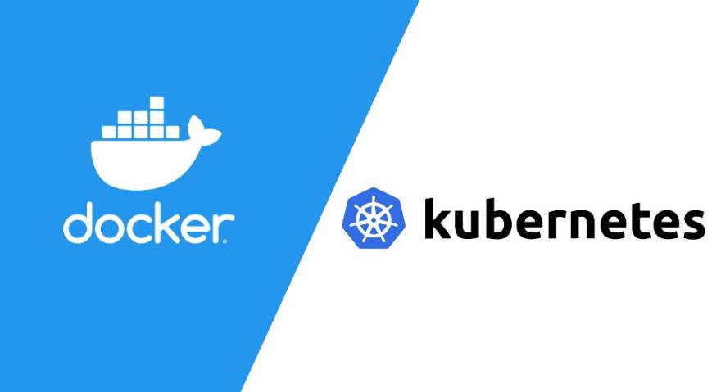
Learning 1 | My takeaways
I learned how to set up Docker, create a container image, and run it, as well as how to install Kubernetes on Linux. I also learned to create a control plane and a worker node using two virtual machines, effectively managing containerized applications.
Understanding Docker and Kubernetes provides the foundation for deploying, scaling, and managing containerized applications efficiently, enabling greater flexibility in software deployment and resource management.
In the energy sector, Shell can use Docker and Kubernetes to streamline the deployment of applications and microservices across global infrastructure. These technologies allow for rapid scaling, better resource optimization, and faster response times, which are essential for handling the complexity of energy operations.

Slide 5

Learning 2 | My takeaways
I learned how to set up Prometheus and Grafana using Docker images, export Nginx metrics with the Nginx metrics exporter, and create a monitoring dashboard in Prometheus to track Nginx server performance.
Prometheus and Grafana are powerful tools for monitoring and visualizing metrics, providing real-time insights into system performance and helping to identify issues before they affect operations.
In the energy sector, Shell can use Prometheus and Grafana to monitor infrastructure performance across various sites, ensuring systems run smoothly. This enables proactive identification of potential issues, improves system uptime, and enhances the overall efficiency of critical operations.

Slide 6

Learning 3 | My takeaways
I learned how to install and use Chef to automate infrastructure tasks, including creating repositories, cookbooks, and recipes, and fully automating Kubernetes installation.
Chef is a powerful automation tool that simplifies infrastructure management, enabling the automated deployment of complex systems like Kubernetes, which enhances operational efficiency and reduces manual intervention.
In the energy sector, Shell can use Chef to automate the deployment and configuration of infrastructure, ensuring consistency across environments. This streamlines operations, reduces human error, and enhances the speed and efficiency of deploying critical systems like Kubernetes in its global infrastructure.

Slide 7

Relevance of learnings for my organization

Slide 8
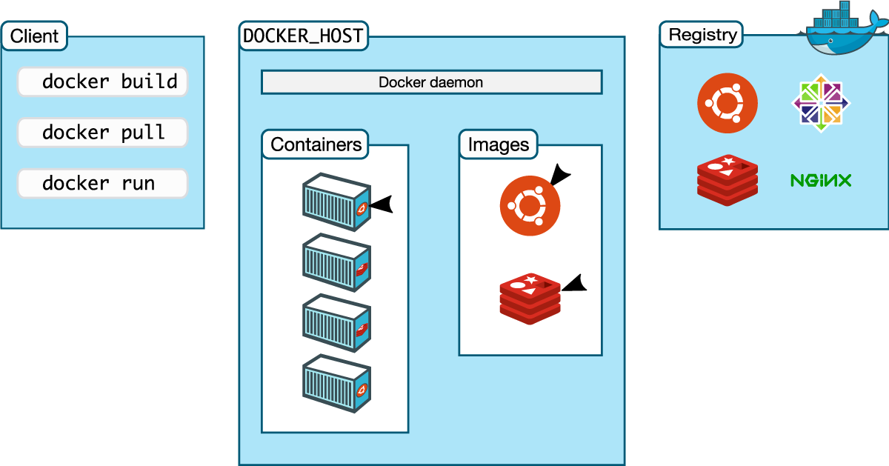
Learning 1 | Relevance for Shell
Shell likely uses Docker and Kubernetes to manage and orchestrate containerized applications across its infrastructure. By using Kubernetes clusters, Shell can ensure efficient scaling and deployment of critical applications in various regions.
These technologies help Shell maintain high availability, reduce downtime, and optimize resource use. With Docker and Kubernetes, Shell can rapidly deploy updates and new services, ensuring smoother operations and faster innovation in the energy sector.

Slide 9
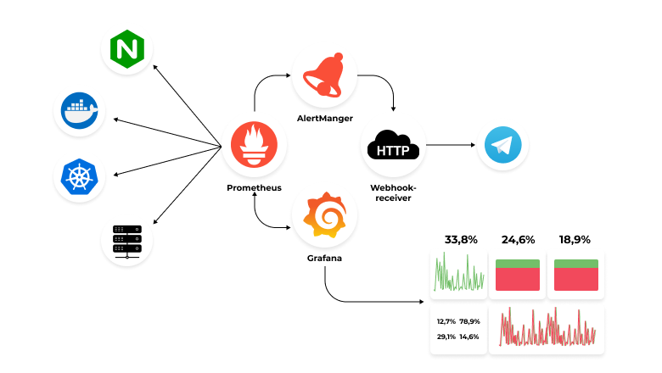
Learning 2 | Relevance for Shell
Shell likely uses Prometheus and Grafana to monitor the health and performance of its global IT infrastructure and energy systems. By exporting metrics from various services and visualizing them through dashboards, Shell can gain real-time insights into its operations.
These monitoring tools allow Shell to detect and address issues quickly, ensuring continuous system availability and optimizing performance. This proactive monitoring reduces downtime, supports energy efficiency, and helps Shell maintain operational excellence across its global infrastructure.

Slide 10
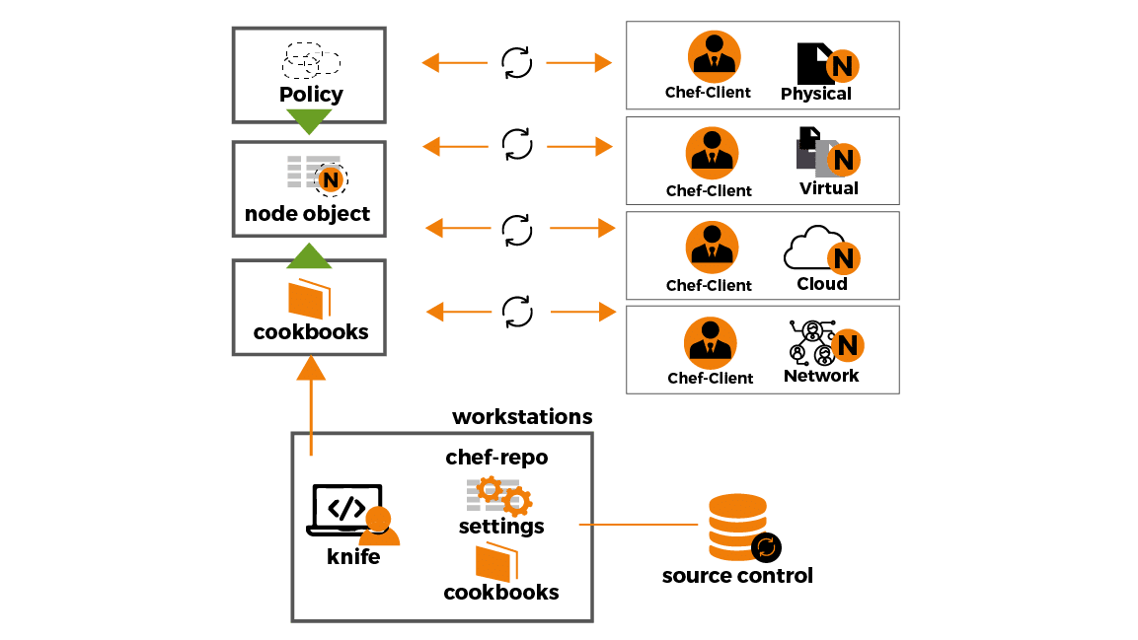
Learning 3 | Relevance for Shell
Shell likely uses Chef to automate infrastructure management, ensuring consistent deployment of services like Kubernetes across its global operations. This helps standardize processes and simplify the management of complex systems.
By automating tasks with Chef, Shell can reduce manual effort, decrease errors, and accelerate deployment times. This enhances operational efficiency, improves scalability, and allows Shell to focus on innovation and optimizing its energy operations.

Slide 11

Challenges in implementing learning

Slide 12
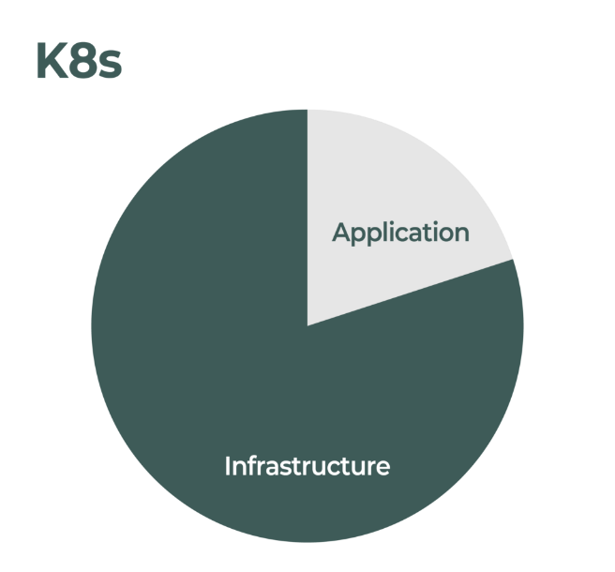
Challenge faced while implementing Learning 1
I encountered issues when installing Kubernetes due to version mismatches and dependency conflicts. These problems made the setup process time-consuming and complicated, requiring manual troubleshooting to resolve.

Slide 13
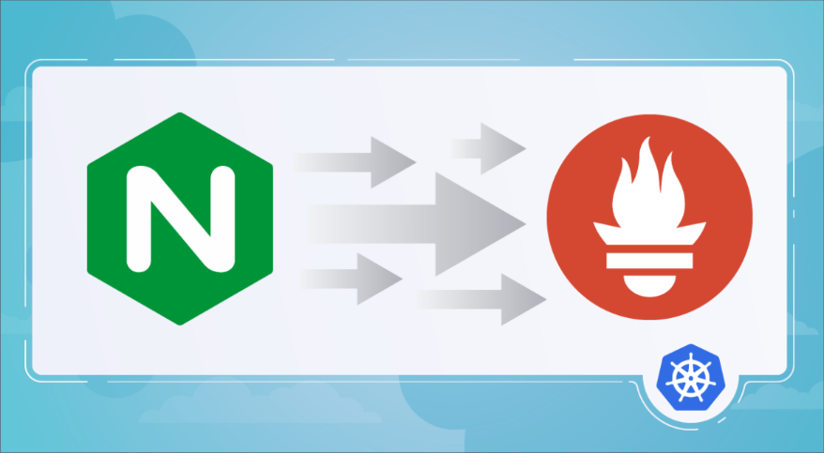
Challenge faced while implementing Learning 2
I had difficulty connecting Nginx to the Prometheus dashboard because Nginx no longer supports direct integration with Prometheus. This required relying on third-party plugins, adding extra steps and complexity to the monitoring setup.

Slide 14
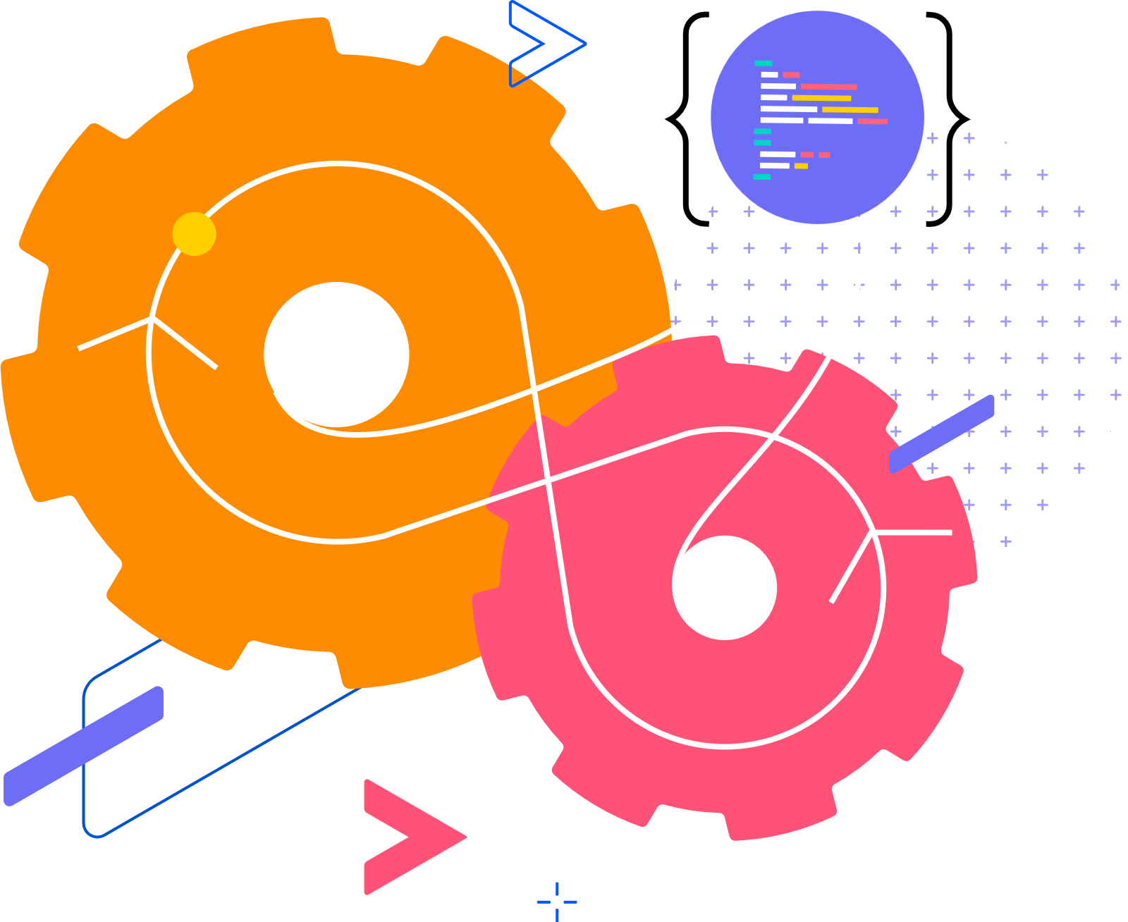
Challenge faced while implementing Learning 3
I struggled with automating Kubernetes pod creation using Chef, as Chef couldn't handle the dynamic values needed from the output of previous commands, making it challenging to fully automate the process without manual intervention.

Slide 15

Action Plan

Slide 16
My Action Plan for this Week
Actions
Timeline
Status
Study Kubernetes version compatibility and dependencies. Explore third-party plugins for Nginx and Prometheus integration. Research Chef’s capabilities for automating Kubernetes pod creation.
Start immediately and focus on researching best practices for Kubernetes installation, testing third-party plugins for Nginx-Prometheus, and exploring Chef’s documentation for automation solutions.
Comfortable navigating ServiceNow and managing tickets efficiently, improved understanding of AWS network configurations, and confident in setting up secure connections between Azure VMs.

Slide 17

Learning is also Fun!

Slide 18
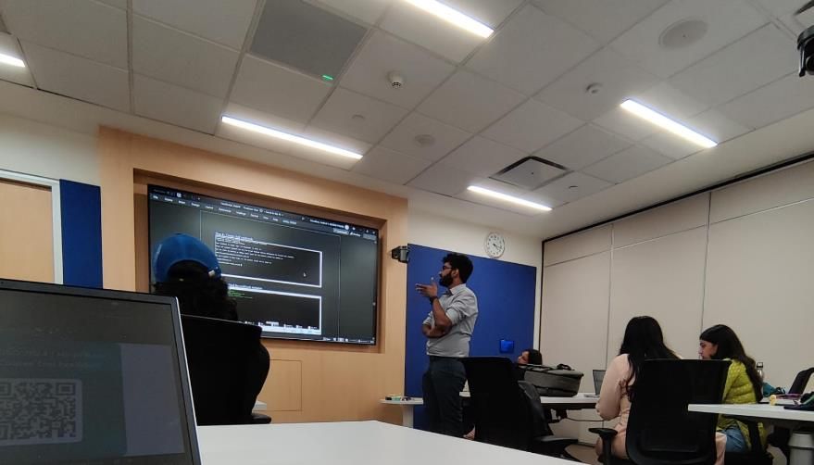
Learning is also Fun!
On the last day, we did our case study project, for that we deployed a flask app using Docker Kubernetes and automated the workflow using Chef. Then we presented our work to others. This was incredibly challenging, but fun and engaging, making it a truly interesting experience.

Slide 19

Summary
This week focused on getting hands-on with Docker, Kubernetes, Prometheus, Grafana, ad Chef.
This week marks the end of our bootcamp, we will be joining our teams from next week.
The tools like Docker and Kubernetes are commonly used in my department and will surely help me in my work.

Slide 20
Thank You

